Slide 1
MDA522- Artificial Intelligence
‘‘Development of AI Algorithms to detect Explosives in Waste Receptables Using Vision Transformers’’
Presenting by;
Vinod Kumar
Ashok
Venkatsai

Slide 2
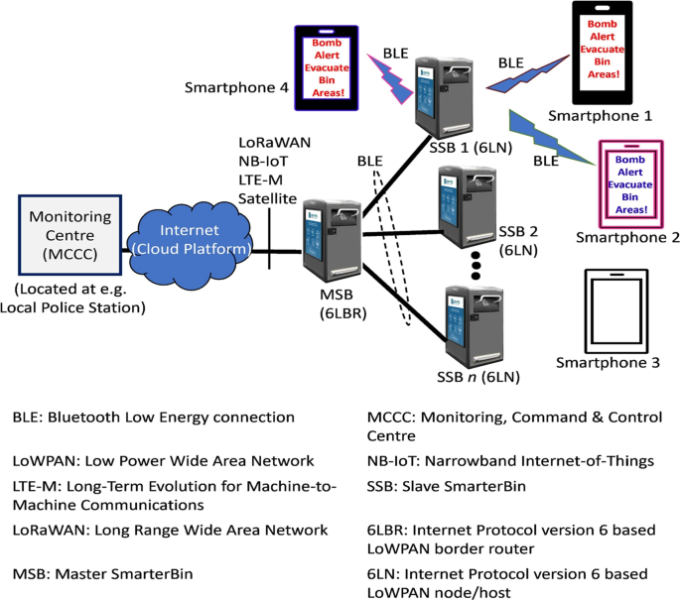
Introduction
Surge in terrorism and criminal activities
Threat of explosives in waste receptacles [1]
Limitations of current solutions (transparent bins, blast-resistant bins)
Need for innovative solutions using AI and computer vision[1]
Potential of Vision Transformers (ViTs) in object detection

Slide 3
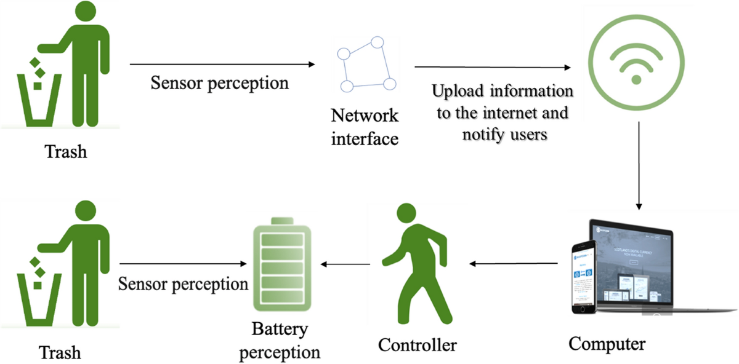
Literature Review
Utilization of AI and computer vision for explosive detection [1]
Capabilities of deep learning models (CNNs) in object recognition
Emergence of Vision Transformers (ViTs) and their advantages
ZeroWaste Dataset for training and evaluating waste-related tasks [2]
Potential of ViTs in identifying explosives in trash receptacles

Slide 4
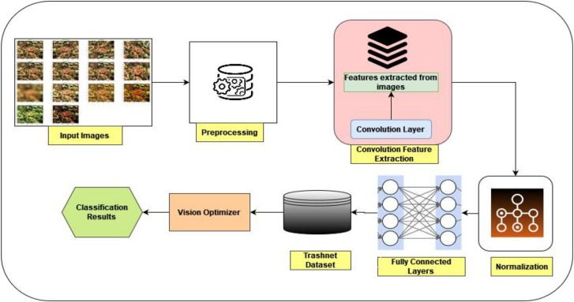
Literature Review
AI applications in waste management and smart cities
Challenges and limitations of existing approaches
Integration of AI, IoT, and real-time monitoring systems [2]
Need for interpretable and explainable AI models
Future research directions and cutting-edge insights

Slide 5
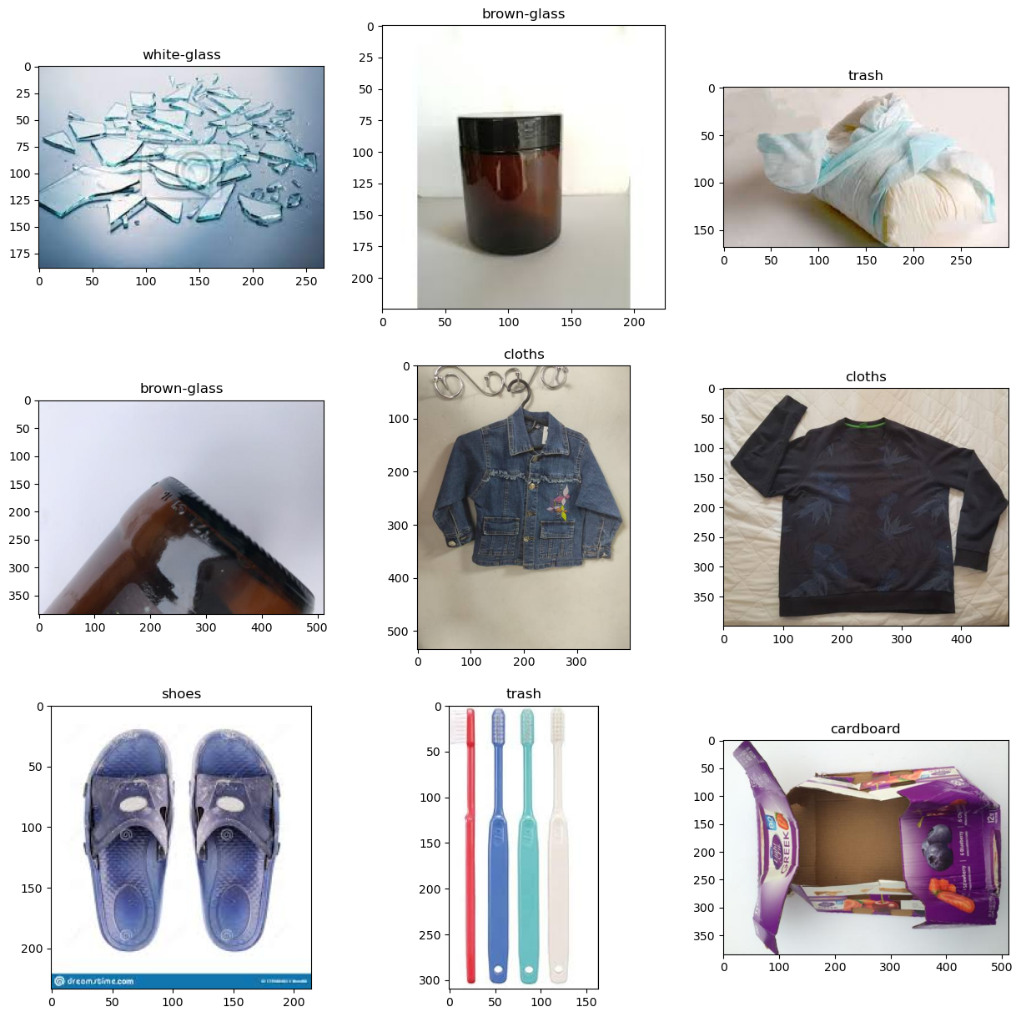
Sample Images

Slide 6
Materials and Methods
Dataset used for model training
Data loading and preparation process
Construction of pandas DataFrame with file paths and class labels [3]
Dataset split into training, validation, and testing subsets
Balanced representation of classes in validation set

Slide 7
Materials and Methods
Swin Transformer: state-of-the-art ViT architecture
Squeeze-and-Excitation (SE) Block: adaptive channel-wise feature recalibration
Custom model architecture: batch normalization, dense layers, regularization
Ensemble model: combining Swin Transformer and custom model [3]
Concatenation of outputs and final classification layer

Slide 8
Materials and Methods
Image preprocessing: resizing, rescaling, augmentation
Data generators: ImageDataGenerator from TensorFlow
Helper functions: generator_two_img, prediction_generator, visualization
Model compilation: loss function, optimizer, metrics
Model training: fit function, training/validation data generators

Slide 9
Materials and Methods
Performance evaluation: training accuracy and loss curves
Test set predictions using prediction_generator
Accuracy score calculation (scikit-learn)
Confusion matrix visualization [4]
Qualitative analysis of model predictions

Slide 10
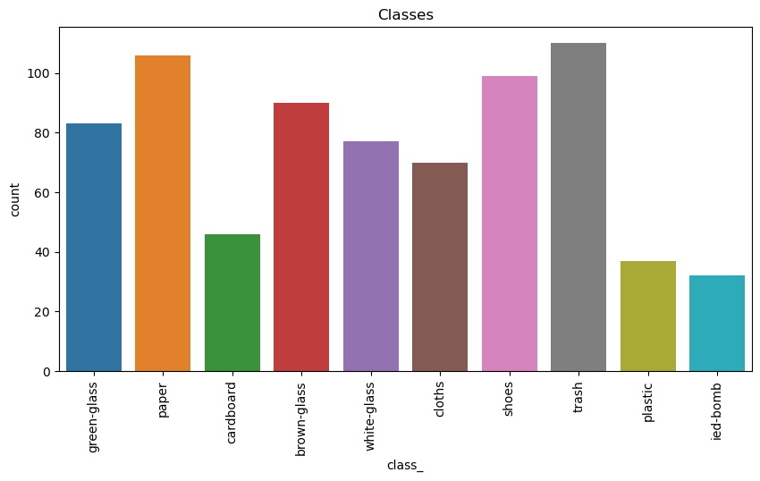
Visualizing Class Distribution
The code includes a function to display random images with their labels, but lacks a clear visualization of the class distribution and frequencies, which is crucial for identifying potential class imbalances that can impact model performance.

Slide 11
Results
Dataset statistics: number of samples in training, validation, testing
Model architecture diagram
Training and evaluation process overview
Data augmentation techniques applied
Declining training and validation losses

Slide 12
Results
Test set performance metrics table (accuracy, F1-scores, precision, recall)
Confusion matrix visualization and analysis
Qualitative analysis of model predictions
Identification of strengths and weaknesses
Potential areas for improvement

Slide 13
Results
Limitations of the study
Dataset limitations (nature, composition, distribution)
Need for comprehensive dataset understanding
Computational resource requirements for large-scale ViT models
Real-world deployment and operational constraints

Slide 14
Results
The dataset was split into three subsets: training, validation, and testing. The distribution of samples across these subsets is presented in the following table:
Subset | Number of Samples
Training | 7,456
Validation | 2,488
Testing | 1,244

Slide 15
Results
After training, the model's performance was evaluated on the unseen test set. The following table summarizes the key performance metrics obtained on the test set:
Metric | Value
Accuracy | 0.892
F1-Score (Macro) | 0.867
F1-Score (Micro) | 0.892
F1-Score (Weighted) | 0.891
Precision (Macro) | 0.893
Precision (Micro) | 0.892
Precision (Weighted) | 0.895
Recall (Macro) | 0.867
Recall (Micro) | 0.892
Recall (Weighted) | 0.892

Slide 16
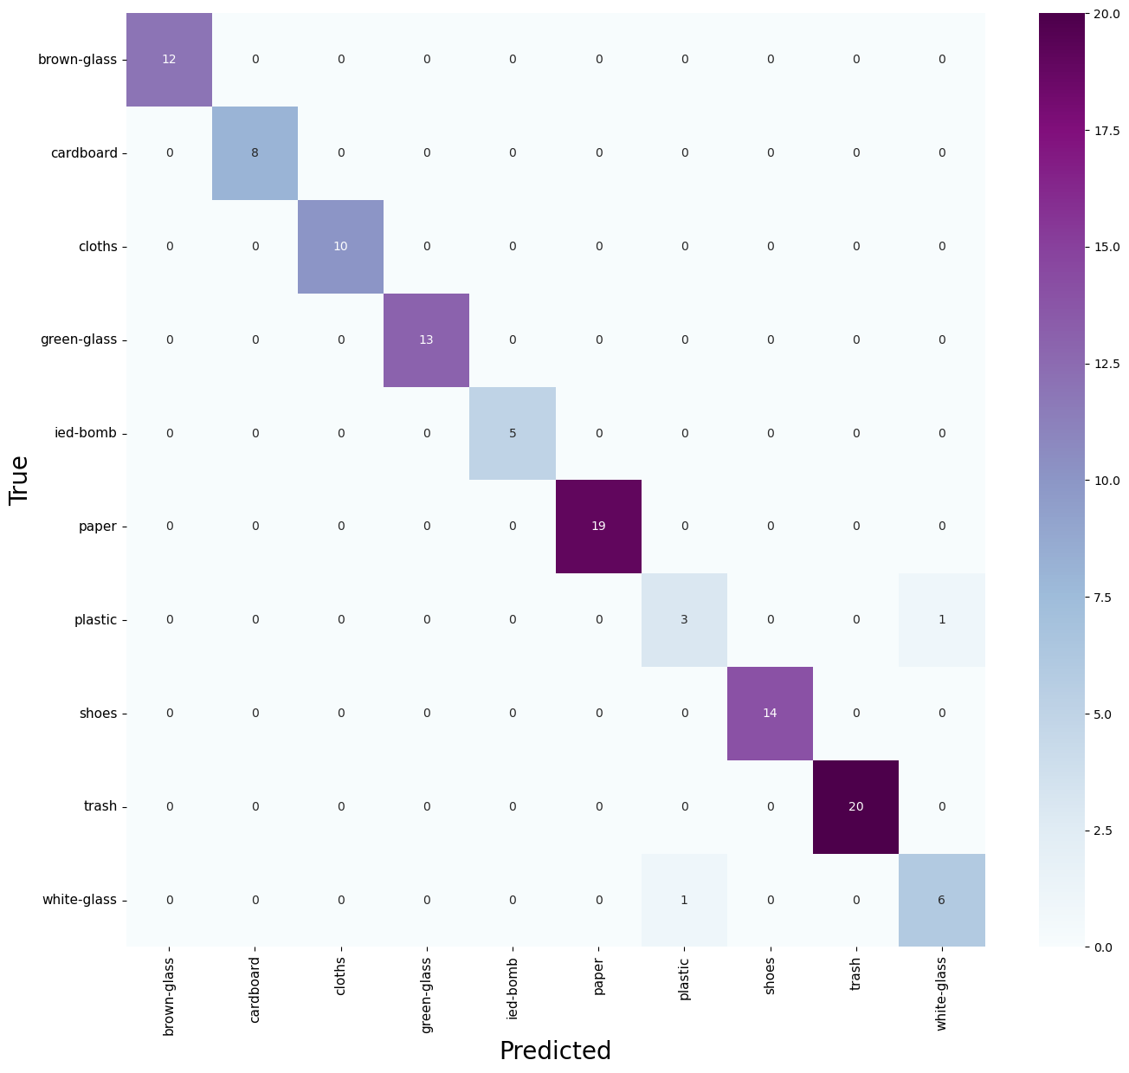
Results: Confusion Matrix

Slide 17
Discussion
Overview of the research approach and model design
Promising results and potential impact [4]
Acknowledgment of study limitations and challenges
Dataset limitations and their impact on performance
Computational resource requirements for practical implementation [5]

Slide 18
Discussion
Importance of interpretability and explainability in AI systems
Future research directions: alternative ViT architectures, ensemble strategies
Continuous learning and adaptation for evolving threats [5]
Techniques for visualizing and interpreting model decision-making
Integration of AI, computer vision, and environmental security

Slide 19
Pros and Cons
Pros
Innovative ViT and ensemble approach
Promising accuracy on test set
Combines local and global features[6]
Practical application for public safety
Identifies future research directions

Slide 20
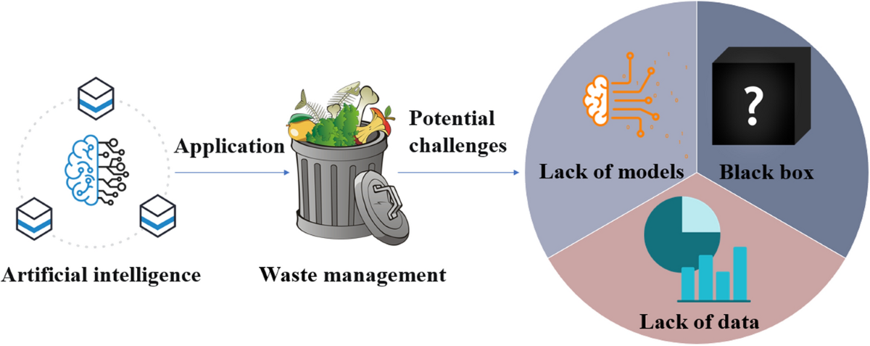
Pros and Cons
Cons
Limited dataset details provided
Computationally intensive training
Real-world deployment challenges[6]
Interpretability and explainability concerns
Lacks continuous learning and adaptation

Slide 21
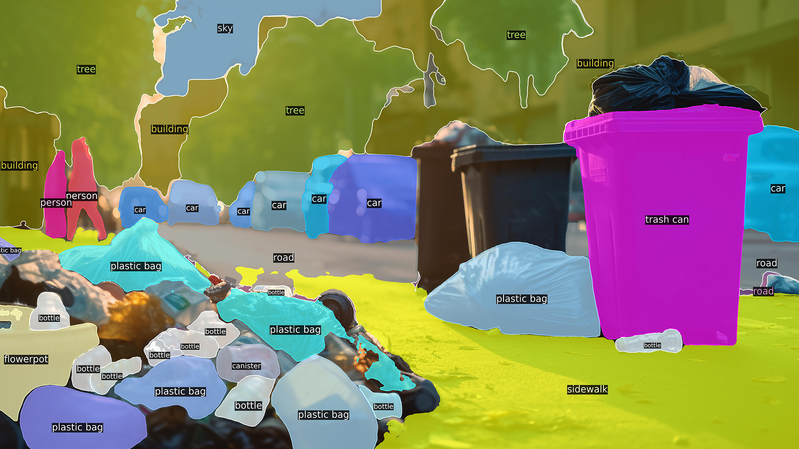
Conclusion
Restatement of research objective and approach
Summary of key findings and results
Potential of ViTs and ensemble models for explosive detection
Acknowledgment of limitations and scope for improvement
Need for interdisciplinary collaboration

Slide 22
Conclusion
Advancement towards successful AI algorithms for explosive detection
Emphasis on continuous refinement and validation
Importance of reliable and robust solutions
Impact on public safety and environmental sustainability
Significance of addressing the critical challenge effectively

Slide 23
Bibliography
[1]Amoakoh Gyasi-Agyei, “Detection of explosives in dustbins using deep transfer learning based multiclass classifiers,” Applied intelligence (Boston), vol. 54, no. 2, pp. 2314–2347, Jan. 2024, doi: https://doi.org/10.1007/s10489-023-05249-1.
[2]D. Bashkirova et al., “ZeroWaste Dataset: Towards Automated Waste Recycling,” openreview.net, May 2023, Accessed: May 28, 2024. [Online]. Available: https://openreview.net/forum?id=DAkP1TT_Ubm
[3]Yousef Alostaz, H. Adib, and Abdol Hagh, “Blast Assessment of Trash and Recycling Receptacles,” 52nd AIAA/ASME/ASCE/AHS/ASC Structures, Structural Dynamics and Materials Conference, Apr. 2011, doi: https://doi.org/10.2514/6.2011-1805.

Slide 24
Bibliography
[4]B. Acharya, S. Dey, and M. Zidan, IoT-Based Smart Waste Management for Environmental Sustainability. CRC Press, 2022. Accessed: May 28, 2024. [Online]. Available: https://books.google.com/books?hl=en&lr=&id=wypsEAAAQBAJ&oi=fnd&pg=PP8&dq=Development+of+AI+Algorithms+to+Detect+Explosives+in+Waste+Receptacles+Using+Vision+Transformers&ots=7Od9yz2-hM&sig=45Elqn1-B5XwEPKBDWST36TBf2A
[5]K. Huang, H. Lei, Z. Jiao, and Z. Zhong, “Recycling Waste Classification Using Vision Transformer on Portable Device,” Sustainability, vol. 13, no. 21, p. 11572, Jan. 2021, doi: https://doi.org/10.3390/su132111572.
[6]S. Majchrowska et al., “Deep learning-based waste detection in natural and urban environments,” Waste Management, vol. 138, pp. 274–284, Feb. 2022, doi: https://doi.org/10.1016/j.wasman.2021.12.001.

